Slide 1


Investigating the Experiences of Female CTF Players
Antonio Martorana², Emily Chang¹, Hanan Hibshi², Alejandro Cuevas²
¹University of Virginia, ²Carnegie Mellon University
Notes:
Hello! My name is Emily Chang and I am a third-year student studying Computer Science at the University of Virginia. I am here to talk about diversity research I performed at Carnegie Mellon University’s Cylab Institute: Investigating the Experience of Female CTF Players.
I wanted to begin by breaking down this title
Women are severely under-represented in cybersecurity. They make up only 24.9% of the tech workforce
CTFs (Capture-the-Flag competitions) are the tool of choice for promoting early interest in cybersecurity. As an example of gamified learning, they promote engagement through competition and learning through collaboration.
Women are also underrepresented in CTFs. For example, picoCTF is one of the largest CTFs in the world and organized by CMU, and women only made up 15% of the players. When it comes to improving gender diversity through CTFs, there isn’t a lot of literature surrounding increasing their presence.
The objective of this study is to identify what underlying factors contribute to the low representation of women in CTFs so that educators and corporations may better work to address them. In doing so, we can reduce the gender gap in cybersecurity.

Slide 2
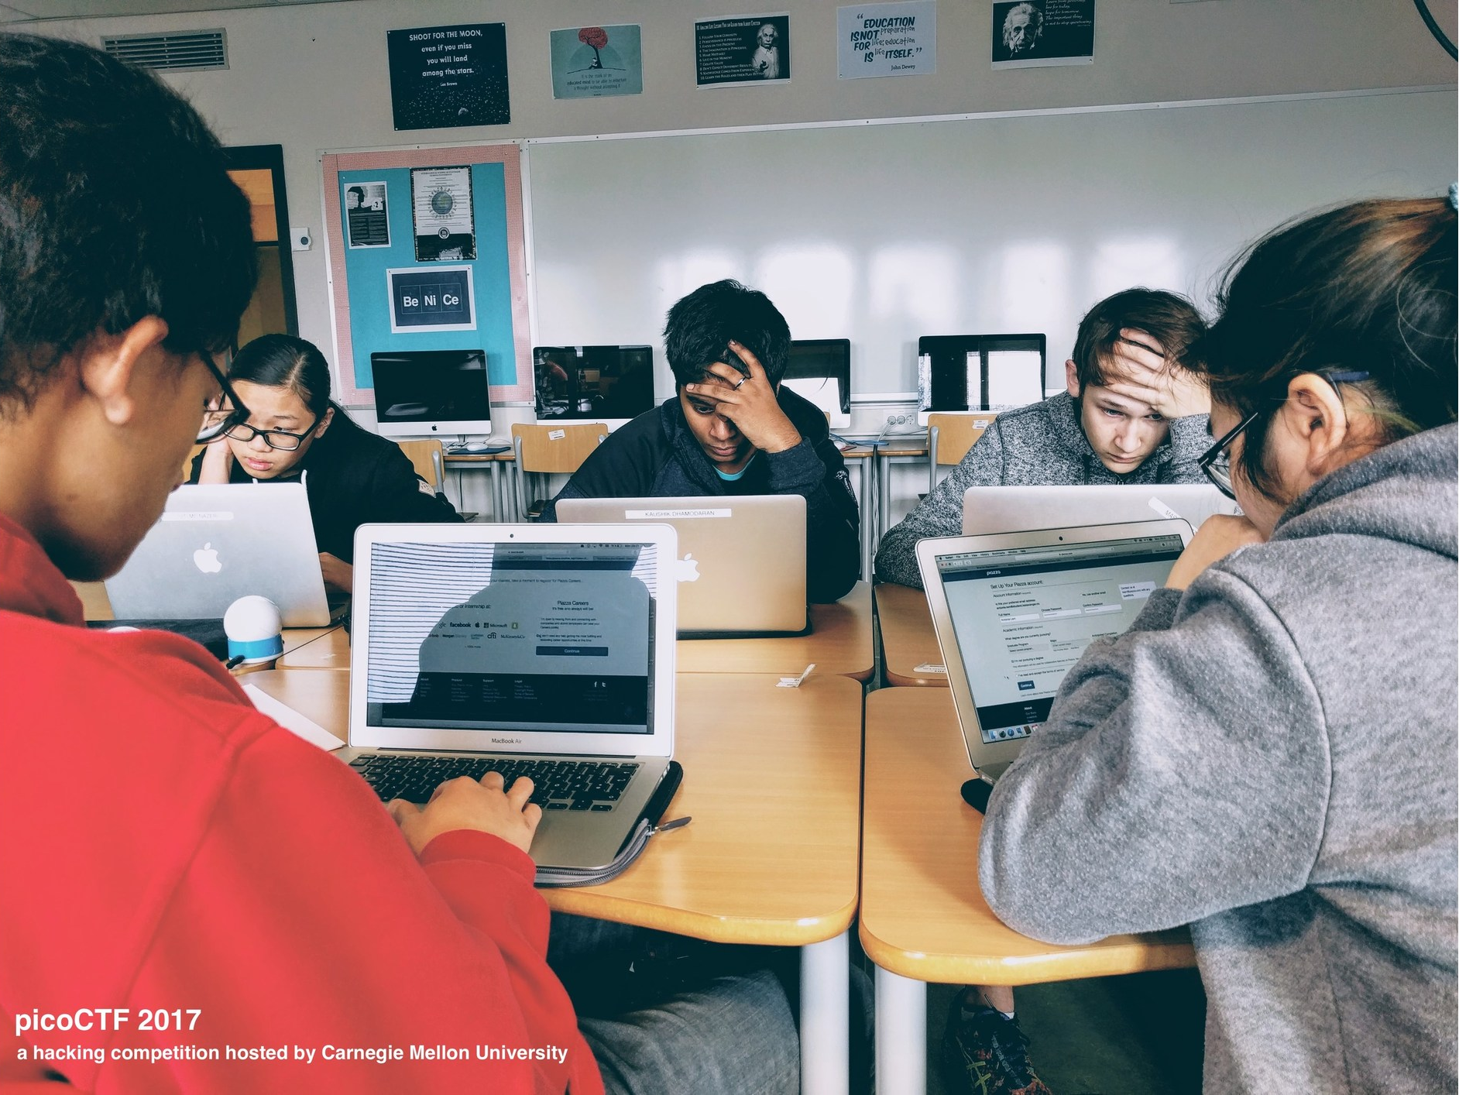
Research Questions
What issues may contribute to low participation in CTFs?
What is the impact of collaboration in succeeding in CTFs?
What educational resources have helped build cyberrelated skills?
Notes:
To address the lack of literature surrounding the presence of women competing in CTFs, we organized a CTF that was women-centered.
Carnegie Mellon University organized an in-person CTF during the 2021 Women in Cybersecurity Conference.
We interviewed 13 CTF participants there and analyzed their responses to provide insight to these research questions
The first question—what issues may contribute to low participation in CTFs—could be attributed to perception.
Participants also mentioned that a lack of technical knowledge or expertise made CTFs more daunting. These feelings were often associated with feelings of imposter syndrome and when solving challenging problems.
Pre-existing inequalities in computer science trickle down into sub-disciplines like cybersecurity. Consequently, the participation of women in CTFs is traditionally low
The second question—what is the impact of collaborating in succeeding in CTFs—can be answered with the preferred team structure
Teams preferred a hierarchal structure where a leader dictated roles to team members.
This enabled accountability: when directly assigned tasks, players remained engaged during parts of the competition
Participants also had the opportunity to shadow more experienced CTF players who had a diverse set of tools and background knowledge.
The third question—what educational resources have helped build cyberrelated skills
Participants highlighted a need for more resources for beginners.
We often say “Google is your best friend” but such a phrase is a double-edged sword. Beginners are often left to navigate the vast amount of tools and information on their own
Participants provided suggestions for increased mentorship via tutors or industry professions and more technological resources to help those from low-income communities
When participants were asked how they advanced their cybersecurity and hacking skills, they reported
gaining experience in security tools and operating tools such as Linux, Wireshark, and Ghidra
A virtual playground where individuals can experiment with tools and systems without consequences was also much desired
To improve the attractiveness of CTFs, participants suggested we focus on targeted outreach and early intervention
Targeted outreach: adapt how CTF platforms and cybersecurity are presented to students who identify as a woman. Generic methods are not enough
Crafting this message for younger individuals is crucial because it can influence the direction an individual will take in their future career

Slide 3
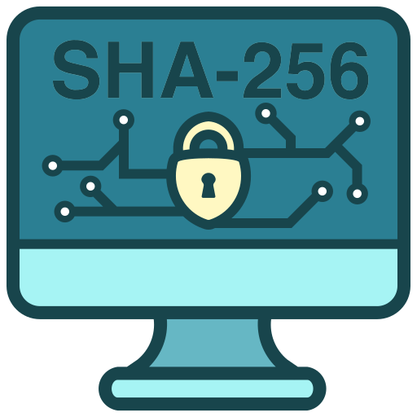
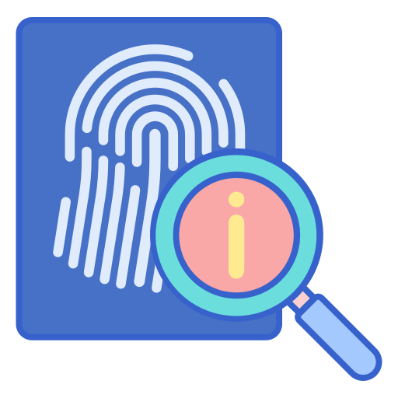







Community Dilemma
individuals feel overwhelmed when navigating interests
join a community
broadness of cybersecurity
cryptography
forensics
reversing
success
failure
binary exploitation
web exploitation
frustration
Notes:
The broad set of sub-disciplines in cybersecurity can cause many to feel overwhelmed.
A common side effect of exploring this field is a mixture of success and failure and sometimes frustration,
Most participants suggested joining a club or community, especially those that promote under-represented backgrounds
A hierarchal team in a CTF is a microcosm of this. More experienced CTF players can mentor those who are new to the field
However, teams are a short-term solution. Once the CTF ends, who can women turn to to fuel their interest?
Finding these communities outside of a CTF can be challenging due to geographical location, lack of awareness in diversity, or harassment
We have a circular issue on our hands
Women might not continue to pursue CTFs and cybersecurity without a support system
But there needs to be an existing support system to recruit women
Who becomes responsible for facilitating this intervention?
This dilemma could be solved by accelerated partnerships and research from industry and academia
Large corporations often have resource groups: forums that enrich belonging and deepen diversity within the company.
What happens if employee in those resource groups went out into the community to mentor those who are new to their field? This can provide the support system that many of our participants have outlined is necessary.

Slide 4

Presentations are limited to three slide: slide one for your name and title, and slide two and three for your content. Please only use two slides for your content. Any additional slides will be deleted to respect time and others that followed the guidelines.

